Slide 1
OSC Virtual Exhibits Hall
Group 2: SEE (Simulated Exhibits Experience)

Slide 2
Members
Andrew Brown
Jacob Millsaps
Joshua Linge
Xue (Allen) Lin

Slide 3
Sponsor
Presagis
http://www.presagis.com/
Joshua West
Jeremy Joseph

Slide 4
Customer
Orlando Science Center
http://www.osc.org/
Brandan Lanman
Kellen Nixon

Slide 5
Overview
SEE is a non-profit project to create a simulation of the Orlando Science Center using the Unity game engine.

Slide 6
Goals
Model OSC Exhibits
Provide educational value
Keeping it fun
Notes:
Educational purpose: critical thinking skills, the scientific method

Slide 7
Requirements
Unity Web Player
First person camera with controls
Lobby area
One functional exhibit
Easy to modify

Slide 8
Project Implementation
Unity3D Engine
MonoDevelop
Blender
Notes:
Addition: Add some slides for Unity and how it is helping us on the project.

Slide 9
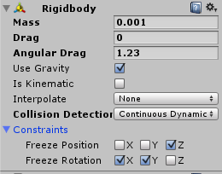
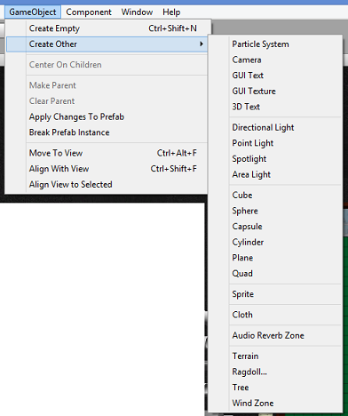
Unity Implementation
Editor
Physics
Basic objects
MonoBehavior
Notes:
Discuss how Unity helps with our project on technical detail.

Slide 10
Project Design
Exhibit framework
Generic components
Individual exhibit rooms
Lobby Center
Gravitron
Pinewood Derby
Notes:
System being the generalized and reusable items. Pause menu, doors, etc…
The purpose for the overall system is to provide a general frameworks across all exhibits.

Slide 11
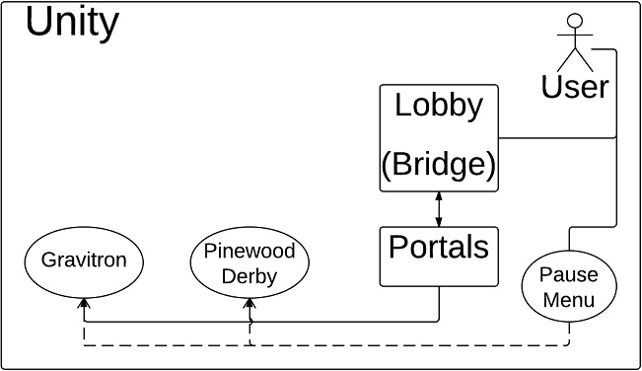
Overall Project Diagram
Notes:
Discuss the User’s interaction with the overall system. The Pause Menu is called from the script that is integrated into the User class and has indirect effect on the Exhibits (will show different menu depending on which Exhibit is currently active).

Slide 12
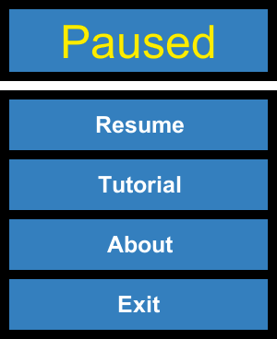
Framework Designs
Player Controller
Pause Menu
Doors interactions
Physical Buttons

Slide 13
Generic Pause Menu
public void pause(Type menuState = null,
int code = GUIState.DEFAULT_CODE) {
paused = true;
Time.timeScale = 0.0f;
cursorScript.showMouse();
startPause();
finiteStateMachine.changeState(menuState, code);
}
public void unPause() {
paused = false;
Time.timeScale = 1.0f;
cursorScript.hideMouse();
exitPause();
finiteStateMachine.clearStateHistory();
}
Notes:
Discuss each function

Slide 14
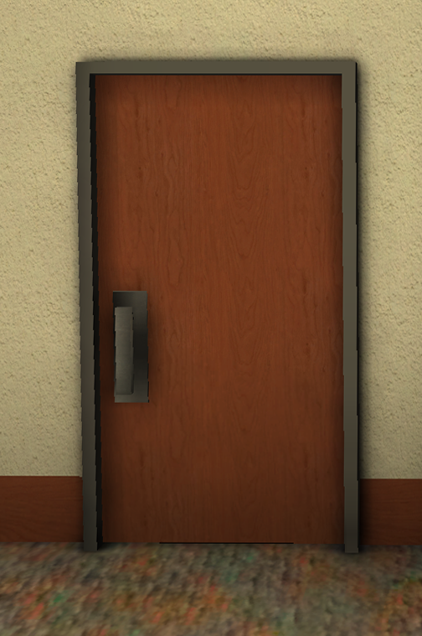
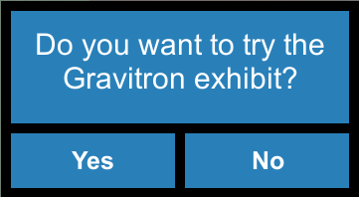
Doors

Slide 15
Prototype Preview

Slide 16
Lobby Center
Central hub
Looks like the OSC
Leads to all the other exhibits
Notes:
Show different prototypes.

Slide 17
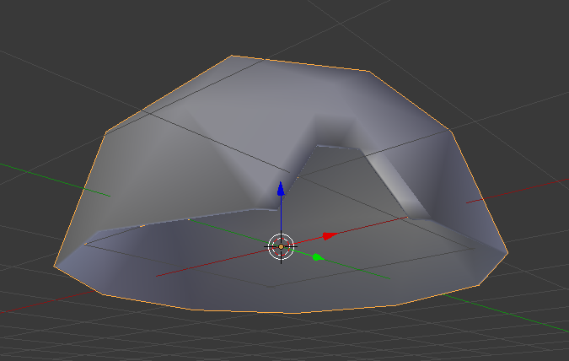
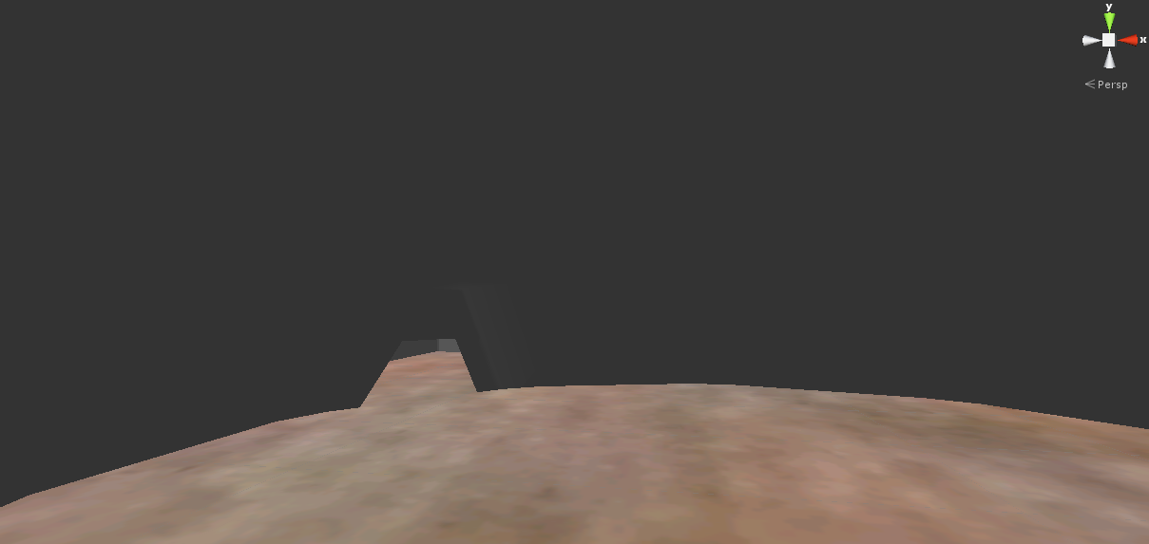
Lobby Prototype 1
Notes:
The distance is hard to tell inside the building.

Slide 18
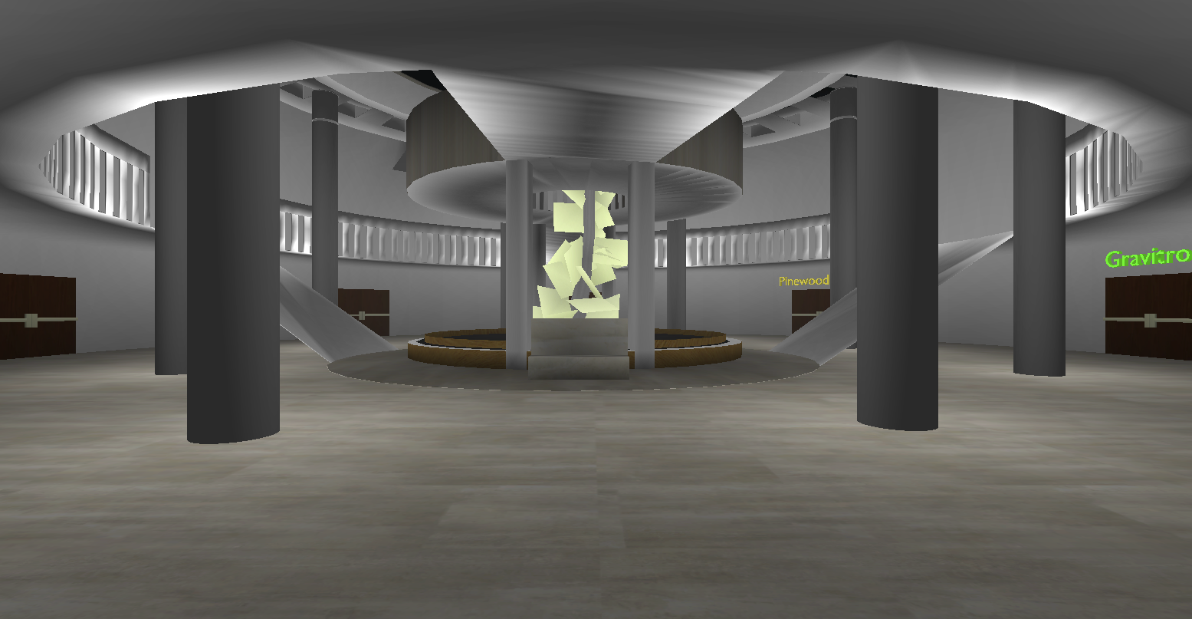
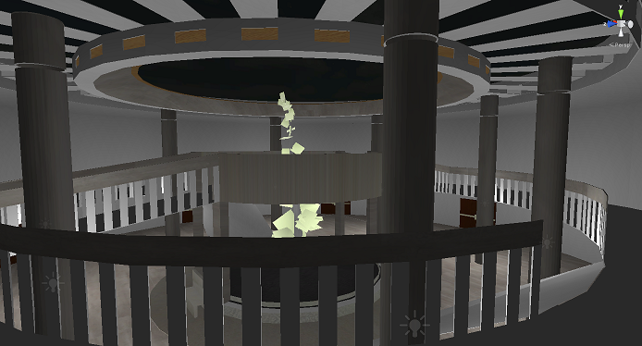
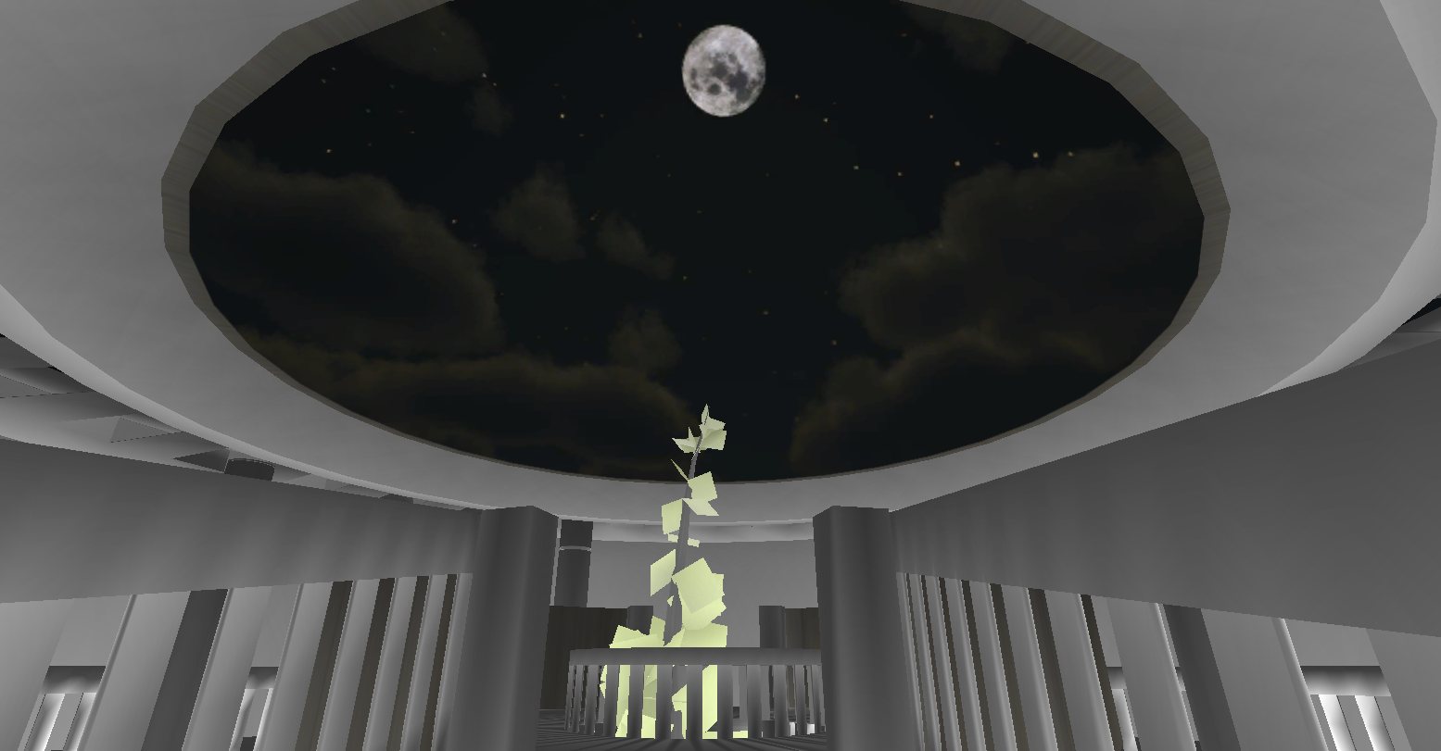
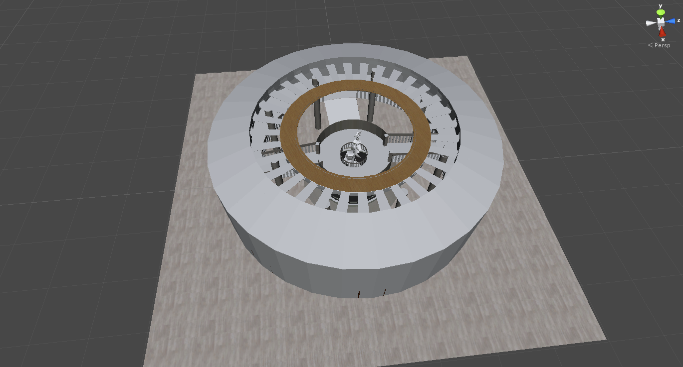
Lobby Prototype 2

Slide 19
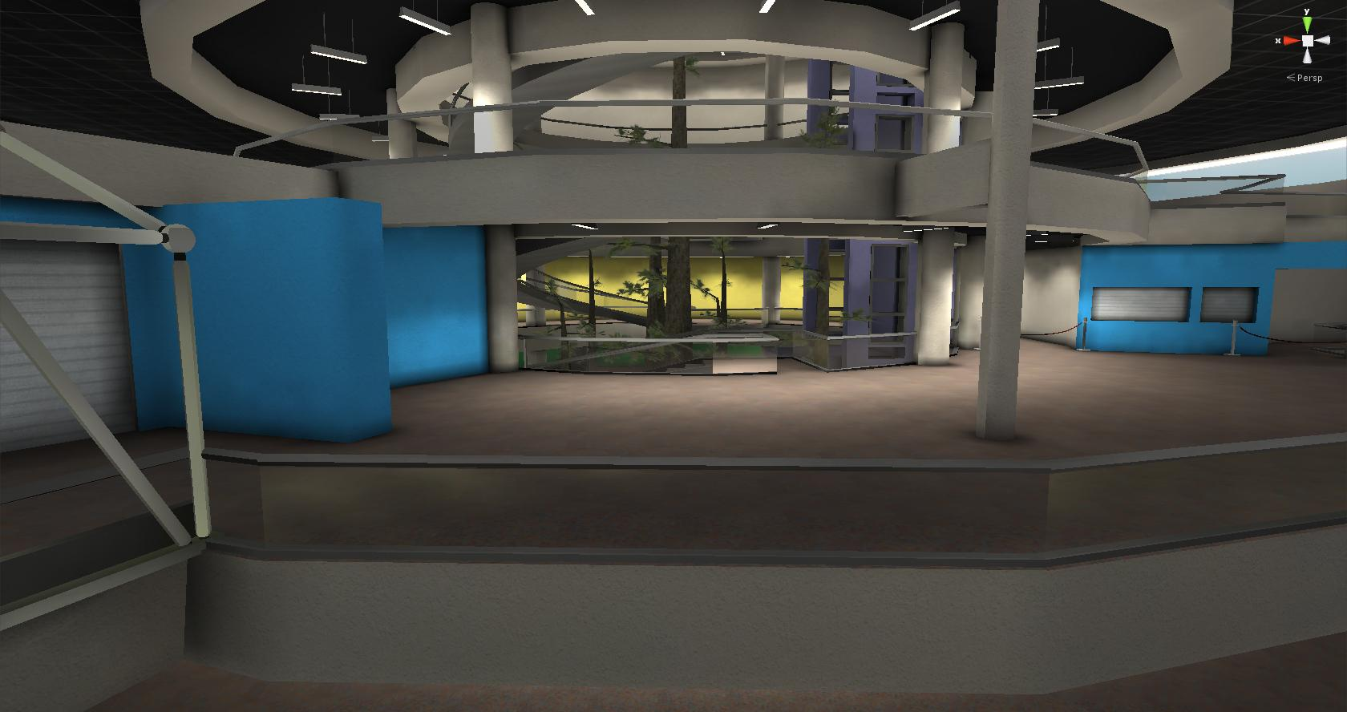
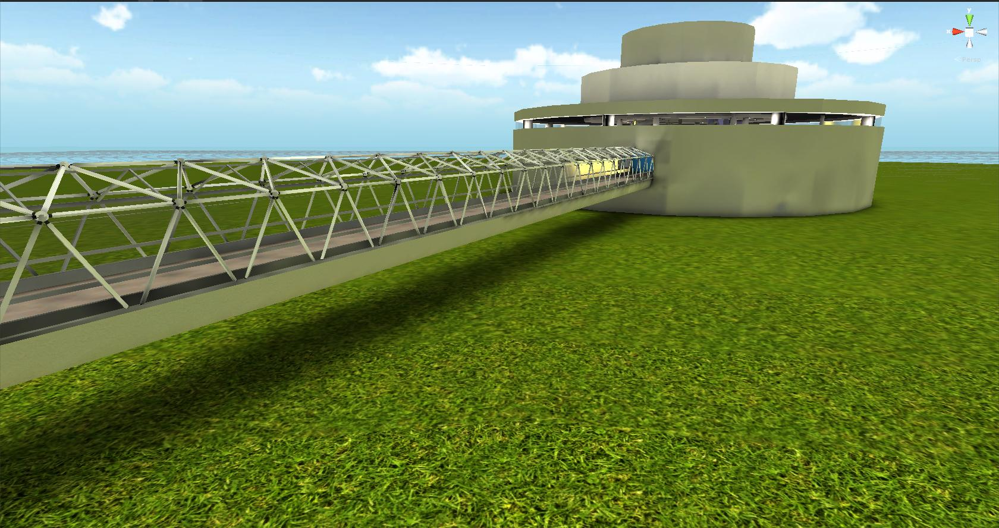
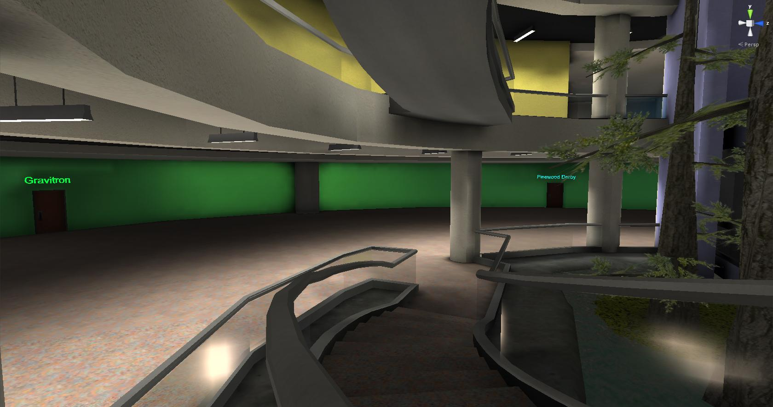
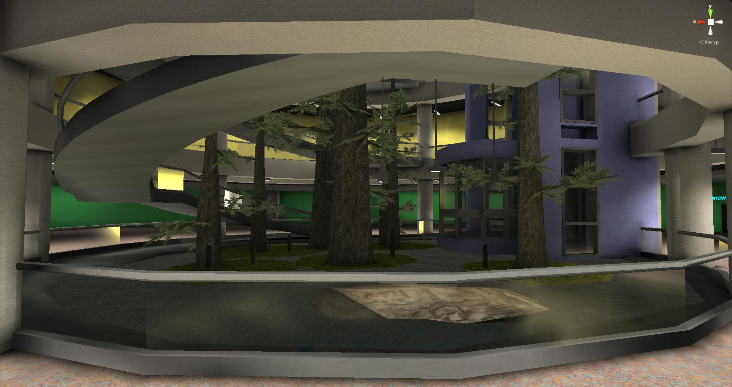
Lobby Prototype 3
Chris Culverwell (Presagis)

Slide 20
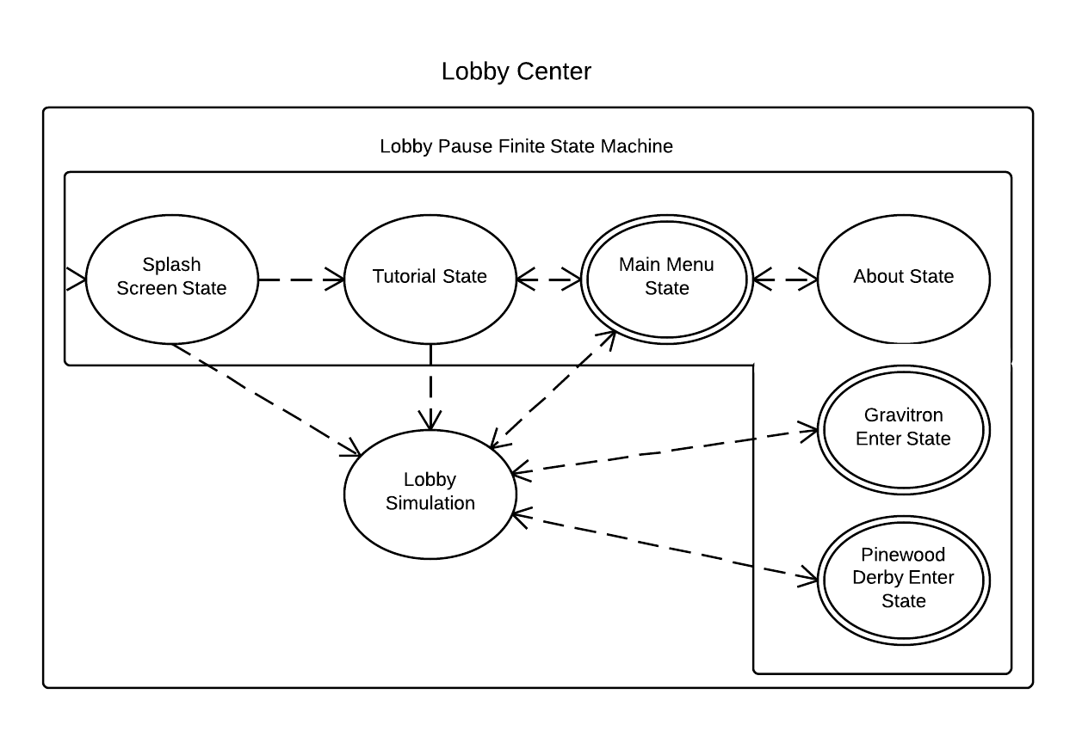

Slide 21
Gravitron Exhibit
Construct a configuration of tubes
Drop a ball into the tubes
Hope it falls in the goal
Learn physics!

Slide 22
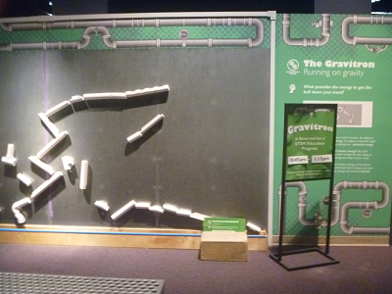
Gravitron Designs
Magnetic wall
Tube objects
Ball object types
Button objects
Challenges

Slide 23
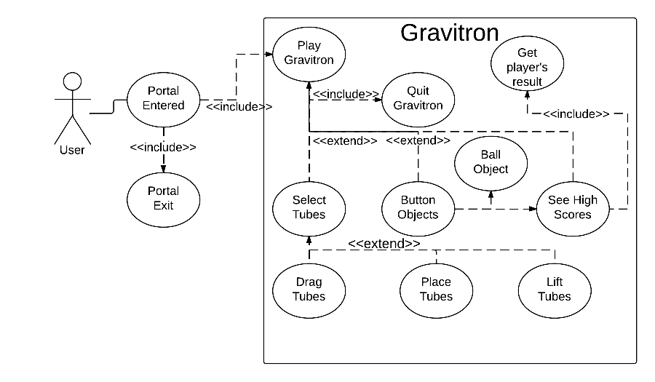
Diagram (cont.)
Gravitron
Notes:
Go through User’s interaction with the Gravitron exhibit. Elaborate on each Button Objects and their purpose.

Slide 24
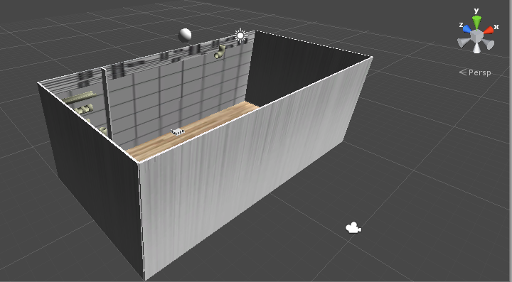
Gravitron Prototype 1
Simplicity
Debugging
Functional components

Slide 25
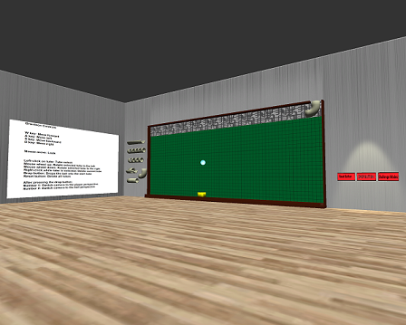
Gravitron Prototype 2
Updated aesthetics
Buttons
Otronicon Prototype

Slide 26
What is Otronicon?
Event held at the OSC
Children and adults tested Gravitron
Many suggestions noted
New bugs discovered
Notes:
We learned that people don’t read!

Slide 27
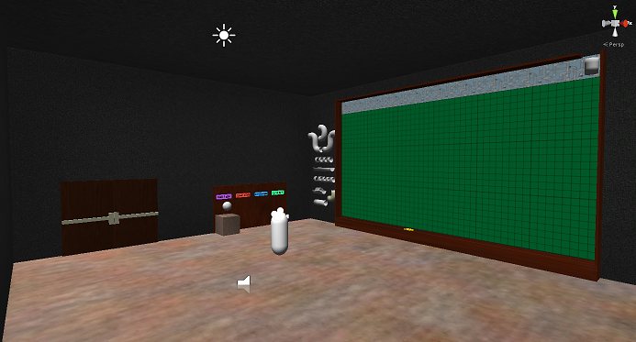
Gravitron Prototype 3
Revamped the environment
Additional Tubes
Additional Buttons
Door

Slide 28
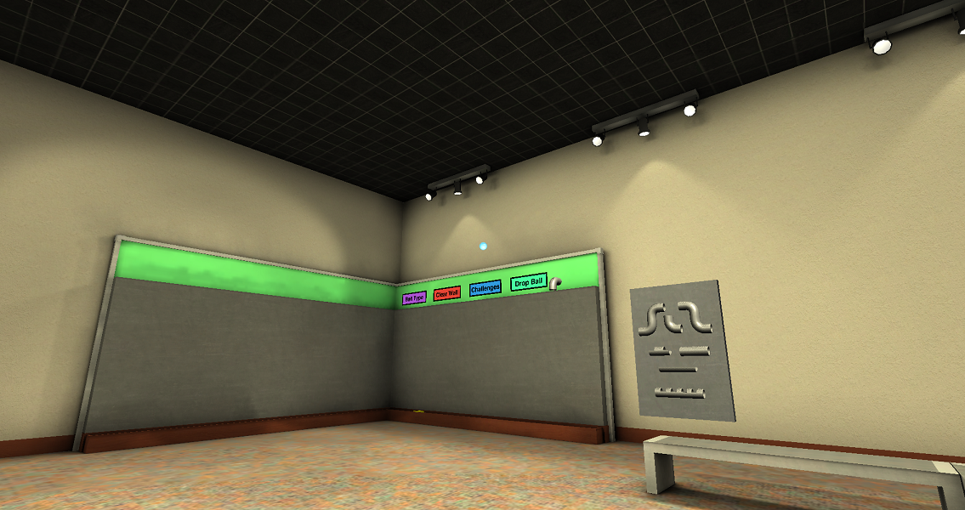
Gravitron Prototype 4
Chris Culverwell (Presagis)

Slide 29
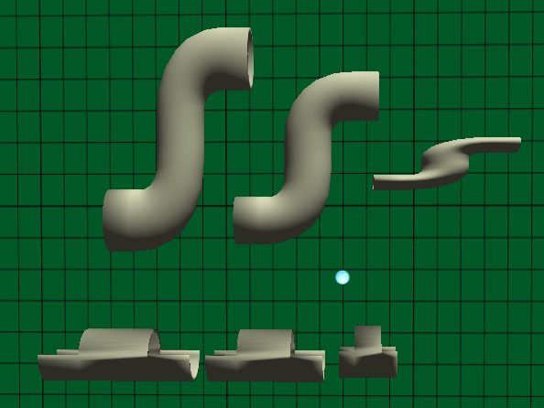
Tube Scaling
Notes:
Here are some features that we implemented for the virtual Gravitron Exhibit.

Slide 30
Tube Scaling
// If player press Q, the selected tube is increasing in length
if (Input.GetKeyDown (KeyCode.Q)) {
if (scalable) {
IncreaseTubeLength();
FollowMouse();
}
}
// If player press E, the selected tube is decreasing in length
else if (Input.GetKeyDown (KeyCode.E)) {
if (scalable) {
DecreaseTubeLength();
FollowMouse();
}
}
Notes:
Scalable boolean value - set individually to each tubes to determine only straightened tubes are scalable.

Slide 31
Tube Scaling
public void DecreaseTubeLength () {
if (transform.localScale.x > 0.2f) {
transform.localScale -= new Vector3(0.1f, 0, 0);
}
}
public void IncreaseTubeLength () {
if (transform.localScale.x < 1.3f) {
transform.localScale += new Vector3(0.1f, 0, 0);
}
}
Notes:
Y-axis instead of X-axis because of the new models

Slide 32
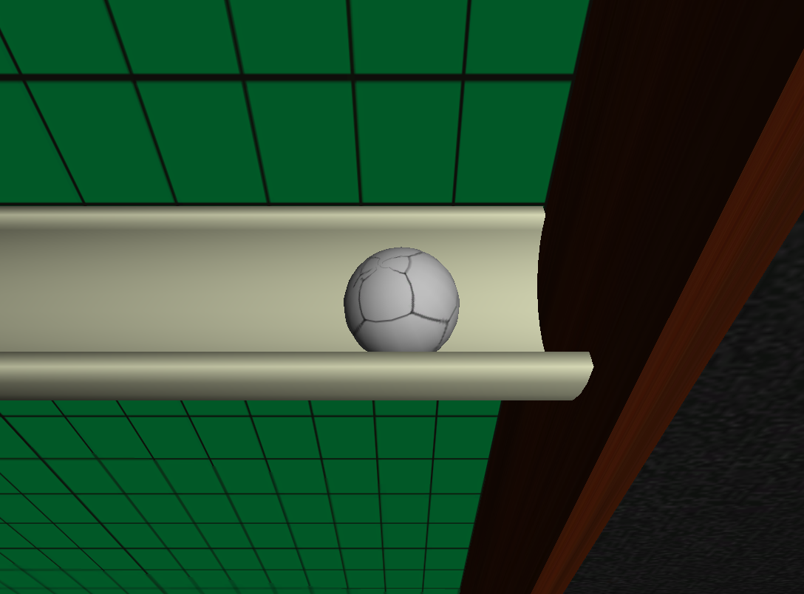
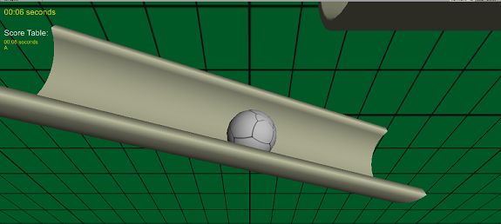
Ball Collision
Notes:
Also talk about the awkward angle in which the ball drops and counts as zero speed.

Slide 33
Ball Collision
// Determining when the Ball stops
if (GetVariables.startSpeedCount) {
if (!stopped && (rigidbody.velocity.sqrMagnitude < .01)
&& (rigidbody.angularVelocity.sqrMagnitude < .01)
&& (Time.time > timeFrame + 1))
// startSpeedCount = false in returnToPlayer()
returnToPlayer();
}
Notes:
Explain rigibody and startSpeedCount

Slide 34
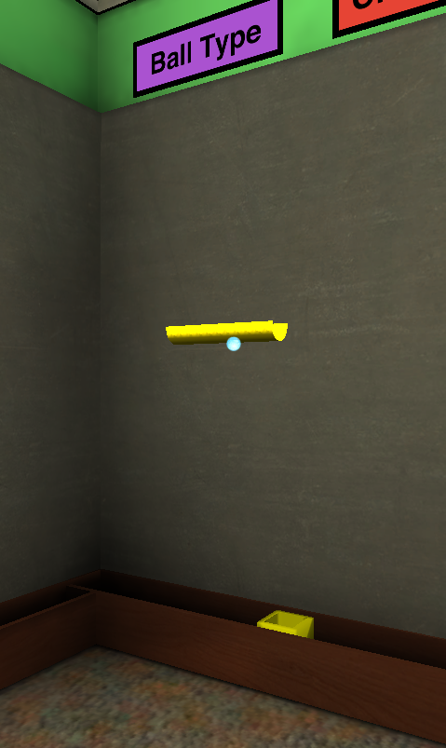
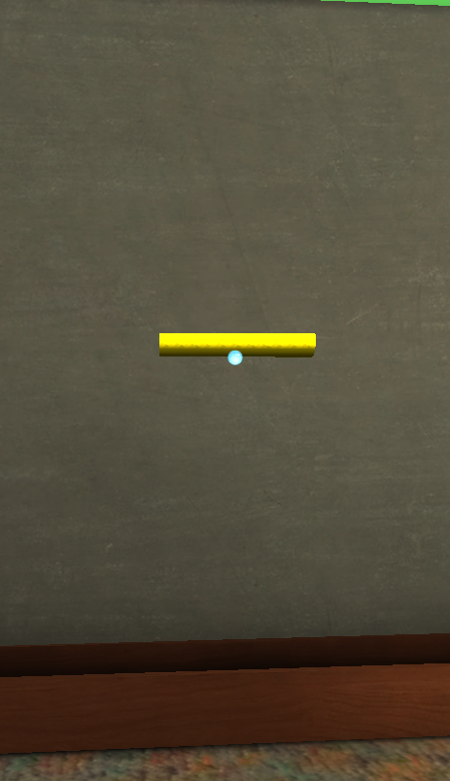
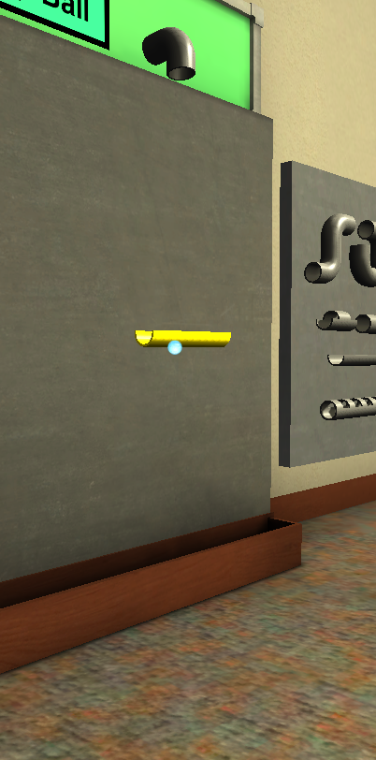
Moving Tubes

Slide 35
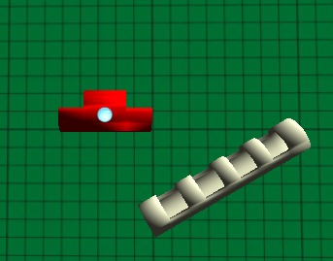
Tube Intersection

Slide 36
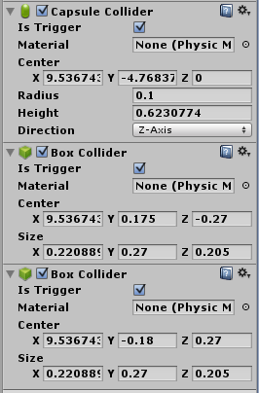
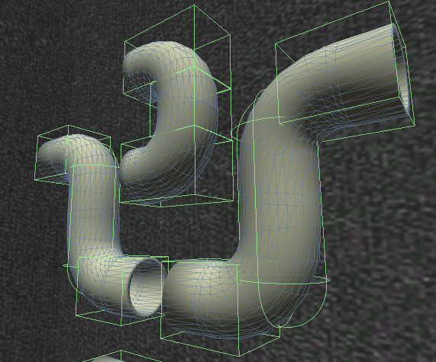
Tube Intersection

Slide 37
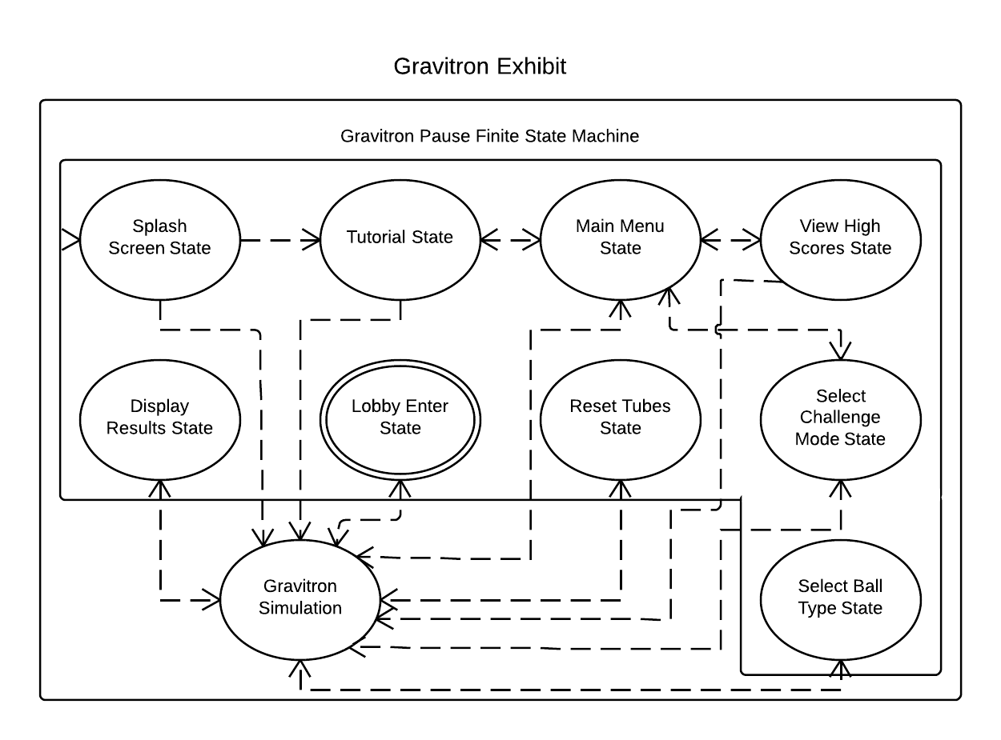
Gravitron Pause Menu

Slide 38
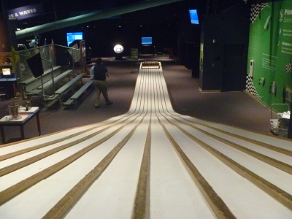
Pinewood Derby Designs
Race track
Car
Workbench

Slide 39
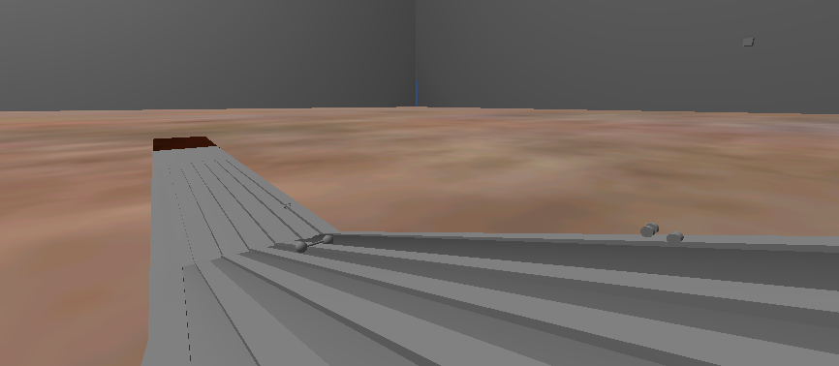
Derby Prototype 1

Slide 40
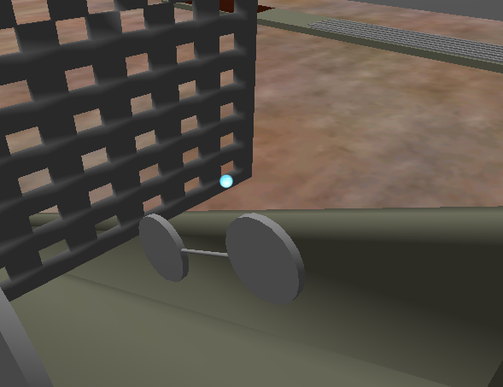
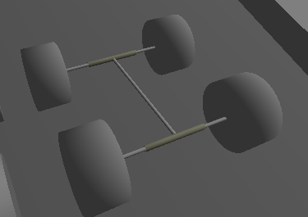
Example Derby Car

Slide 41
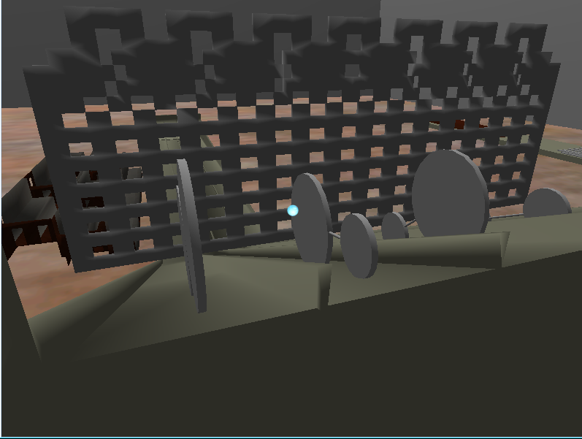
Derby Prototype 2

Slide 42
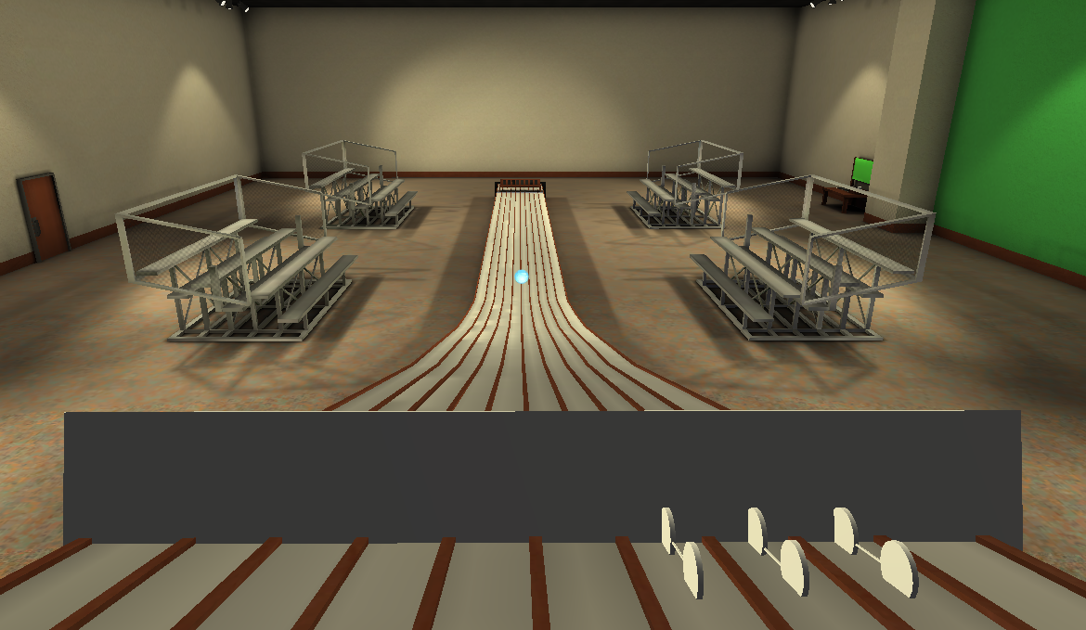
Derby Prototype 3
Chris Culverwell (Presagis)

Slide 43
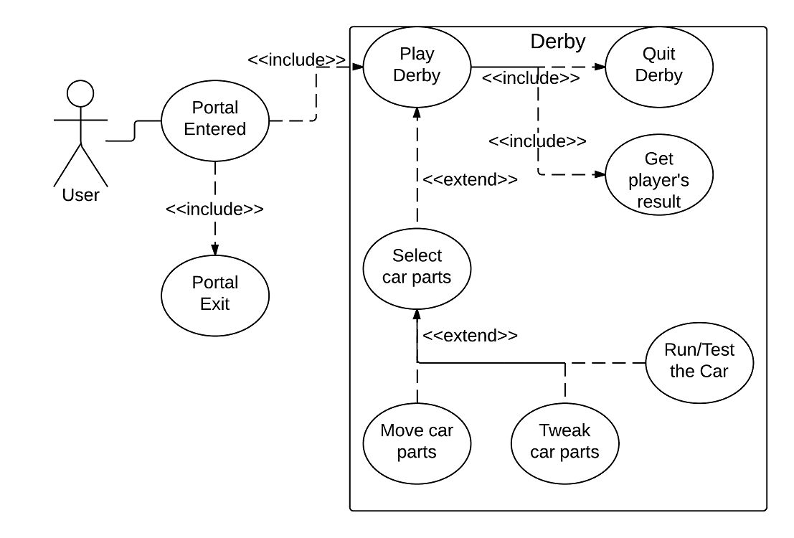
Pinewood Derby

Slide 44
Car Components
Adjustable components
Wheel size
Can be different on front and back
Chassis length
Greater effect vs adjusting wheel position
Additional weight
Adjustable position and size
Fixed sizes for parts

Slide 45
Car Assembly
Methods of assembling car parts
Click on part to place
Car on table matches car on ramp
Current weight of car is shown

Slide 46
Derby Car Physics
Main issues for simulation:
No worrying about real-life “fine-tuning” issues
Limited part selection simplifies physical model
Simulation done in 2D, appears 3D

Slide 47
Derby Car Physics
Rigid-body approach
Works with Unity physics engine
Visible car body drawn over invisible physics objs
Pathfinding approach
Car follows invisible path placed on track
Car configuration only affects movement speed
May limit track creativity

Slide 48
Distribution of Work
Framework - Allen, Josh
Lobby - Allen, Josh
Gravitron - Andrew, Allen, Josh
Pinewood Derby - Andrew, Allen, Jacob

Slide 49
Andrew Brown
Prototype modeling
Communication
Pinewood Derby initial setup

Slide 50
Jacob Millsaps
Pinewood Derby
Car
Physics
Adjustability
Tutorial images and theme

Slide 51
Joshua Linge
Generic Framework
Exhibit Pause Menus
Gravitron
Moving tubes
Tube intersection
Challenge Modes
Bug fixes

Slide 52
Xue (Allen) Lin
Setting up the foundation
Majority of the prototype models
Continued working on Gravitron
Assisting with Pinewood Derby

Slide 53
Demo

